Slide 1
Bert + FineTuning

Slide 2
BERT - Bidirectional Transformer Encoders (Devlin et al., 2019)
Causal (left-to-right) transformers that can serve as the basis for powerful language models—models that can easily be applied to autoregressive generation problem
However, when applied to sequence classification and labeling problems causal models have obvious shortcomings: we’ll want to be able to take into account information from the right context as we process each element

Slide 4
BERT
The causal models are generative models, designed to easily generate the next token in a sequence.
But the focus of bidirectional encoders is instead on computing contextualized representations of the input tokens.

Slide 5
Architecture With bidirectional encoders we simply skip the mask, allowing the model to contextualize each token using information from the entire input.

Slide 6
Architecture With bidirectional encoders we simply skip the mask, allowing the model to contextualize each token using information from the entire input.

Slide 7
Architecture

Slide 8
Training Bidirectional Encoders:MLM
Objective of a Language Model
Objective of a BERT
CLOZE Task (Taylor, 1953).
Masked Language Modeling (MLM)
In BERT, 15% of the input tokens in a training sequence are sampled for learning.
Of these, 80% are replaced with [MASK],
10% are replaced with randomly selected tokens, and
the remaining 10% are left unchanged.
The MLM training objective is to predict the original inputs for each of the masked tokens using a bidirectional encoder.
The cross-entropy loss from these predictions drives the training process for all the parameters in the model.
Note that all of the input tokens play a role in the self-attention process, but only the sampled tokens are used for learning.

Slide 9
Training Bidirectional Encoders:MLM

Slide 10
Training Bidirectional Encoders:MLM

Slide 11
Training Bidirectional Encoders:NSP
an important class of applications involves determining the relationship between pairs of sentences. These include tasks like paraphrase detection (detecting if two sentences have similar meanings), entailment (detecting if the meanings of two sentences entail or contradict each other) or discourse coherence (deciding if two neighboring sentences form a coherent discourse).

Slide 12
Fine-Tuning Language Models
In fine-tuning, we create applications on top of pretrained models by adding a small set of application specific parameters. The fine-tuning process consists of using labeled data about the application to train these additional application-specific parameters. Typically, this training will either freeze or make only minimal adjustments to the pretrained language model parameters.

Slide 13
Fine-Tuning Language Models

Slide 14
Fine-Tuning Language Models

Slide 15
Fine-Tuning Language Models

Slide 16
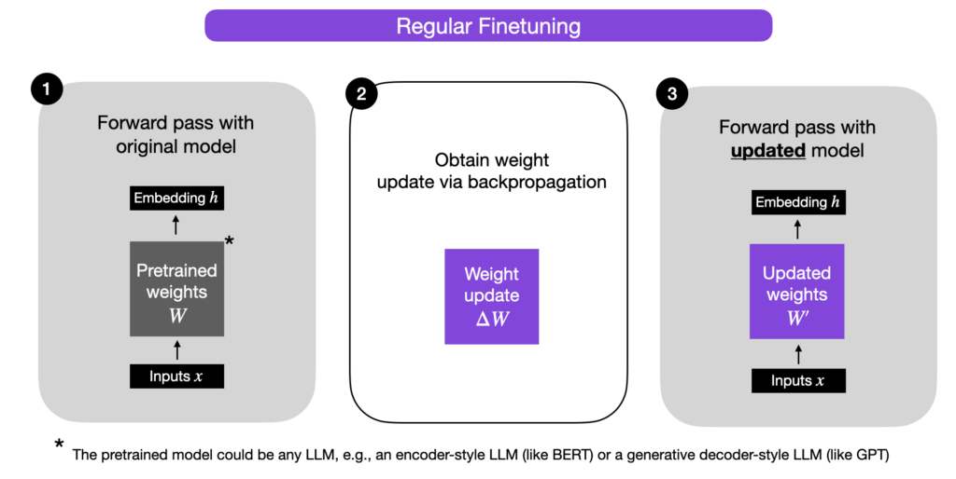
Advancement in Finetuning

Slide 17
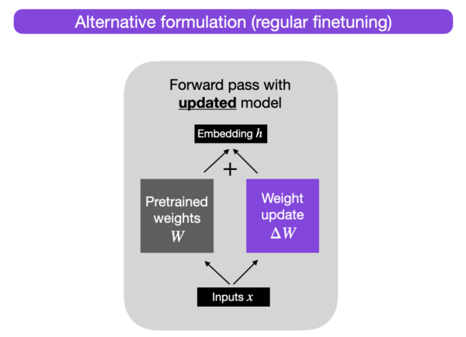
Advancement in Finetuning

Slide 18
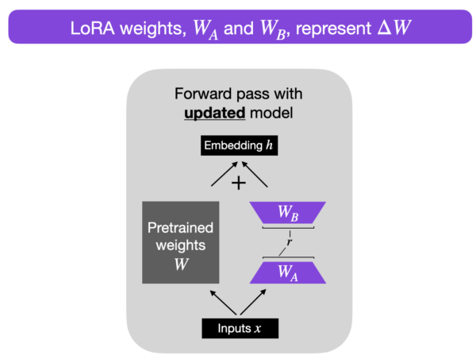
Advancement in Finetuning Reference - https://lightning.ai/pages/community/article/lora-llm/
def lora_forward_matmul(x, W, W_A, W_B):
h = x @ W # regular matrix multiplication
h += x @ (W_A @ W_B)*alpha # use scaled LoRA weights
return h
In the pseudo-code above, alpha is a scaling factor that adjusts the magnitude of the combined result (original model output plus low-rank adaptation). This balances the pretrained model’s knowledge and the new task-specific adaptation — by default, alpha is usually set to 1.
Also note that while W_{A} is initialized to small random weights, W_{B} is initialized to 0 so that
ΔW = W_{A} W_{B} = 0
at the beginning of the training, meaning we begin the training with the original weights.

Slide 19
Why LORA
Parameter efficiency
The new matrices W_{A} and W_{B} can be very small. For example, suppose A=100 and B=500, then the size of ΔW is 100 × 500 = 50,000. Now, if we decompose this into two smaller matrices, a 100×5-dimensional matrix W_{A} and a 5×500-dimensional matrix W_{B}. These two matrices only have 5× 100 + 5 × 500 = 3,000 parameters in total.
Why we keep the original weights W and the matrices W_{A} and W_{B} separate after training
imagine we want to keep our pretrained model as a base model for various customers, and we want to create a finetuned LLM for each customer starting from the base model. In this case, we don’t need to store the full weight matrices W’ for each customer, where storing all the weights W’ = W + W_{A} W_{B} for a model can be very large for LLMs, since LLMs typically have billions to trillions of weight parameters. So instead, we can keep the original model W and only need to store the new lightweight matrices W_{A} and W_{B}.
To illustrate this point with concrete numbers, a full 7B LLaMA checkpoint requires 23 GB of storage capacity, while the LoRA weights can be as small as 8 MB if we choose a rank of r=8.

